Slide 1
Automated Grocery Billing System Using Computer Vision and Deep Learning Techniques Domain: Computer Vision
Final Review

Slide 2
Abstract
This project presents a vision-based grocery item recognition and billing system designed to streamline retail operations through automation. Utilizing the Freiburg Groceries Dataset, which includes images of common supermarket items captured under varied real-world conditions, we trained a YOLOv8 (You Only Look Once, Version 8) model to detect and classify products such as rice, pasta, milk, and more. The model accurately identifies multiple items within a single image and overlays bounding boxes for visualization. A custom billing logic processes the detected items, calculates their quantities, and generates the total cost based on predefined prices. This system offers a practical solution for real-world applications such as cashier-less checkouts, smart shopping trolleys, inventory monitoring, and assistive tools for visually impaired shoppers, ultimately enhancing the efficiency and user experience in retail environments.

Slide 3
Introduction
Manual billing in supermarkets is slow, error-prone, and dependent on barcode scanning, which limits efficiency and scalability.
Computer vision, especially real-time object detection models like YOLO, has opened up new possibilities for automating retail processes.
Our project proposes a cost-effective solution using YOLOv8 trained on the Freiburg Groceries Dataset to detect grocery items directly from images.
Detected items are linked with a billing system that calculates the total price based on item count and predefined rates.
This approach reduces human effort, improves speed and accuracy, and enables potential deployment in smart kiosks, self-checkout counters, and assistive systems.
Our contributions include an end-to-end pipeline for grocery detection and billing, demonstrating the real-world application of deep learning in retail automation.

Slide 4
Need of study
Traditional billing systems in supermarkets rely heavily on barcode scanning, which is time-consuming and inefficient in high-volume environments.
Human intervention in checkout processes increases the risk of errors and reduces customer satisfaction due to long queues.
Vision-based object detection offers a faster, more scalable solution for real-time item recognition and billing.
Affordable alternatives to high-cost infrastructure like RFID and sensor-based systems are needed for broader adoption in retail.
The integration of YOLOv8 with grocery datasets enables lightweight, accurate, and real-time automation that aligns with the growing demand for smart retail solutions.

Slide 5
Problem Statement
The traditional grocery store billing process is time-consuming as each item must be scanned individually, leading to long queues and customer inconvenience. Our work aims to develop an AI-powered billing system that automatically detects grocery products from images and generates a bill. With the help of computer vision and deep learning techniques, our work aims to reduce checkout time, eliminate manual scanning, and improve the overall shopping experience.

Slide 6
Objectives
Automate the Billing Process: Develop a system that eliminates manual barcode scanning by automatically identifying grocery items through real-time object detection.
Enhance Checkout Efficiency: Reduce customer wait times and improve overall shopping experience by speeding up the billing process.
Leverage Deep Learning for Object Recognition: Utilize the YOLO object detection model to accurately detect and classify grocery items from images or video feed.
Build a Scalable and Cost-Effective Solution: Design a system that can be easily deployed in retail environments with minimal hardware requirements.
Promote Contactless and User-Friendly Retail Experiences: Enable seamless and hygienic transactions in the post-pandemic world using AI-driven automation.

Slide 7
Related Work – (4-5 papers)
Paper Title | Authors | Year | Methodology Used
Intelligent Billing System Using Object Detection | Chidella, N., Reddy, N. K., Reddy, N. S. D., Mohan, M., & Sengupta, J. | 2022 | YOLOv3-based object detection for identifying products, integrated with a billing logic for automated supermarket checkout
Automatic Food Billing System of Indian Food using YOLOv8 Model | Meenpal, T., Khan, M. S., & Sahu, M. | 2024 | YOLOv8 for real-time food item detection, implemented in an automatic food billing system targeting Indian cuisine
The Freiburg Groceries Dataset | Jund, P., Abdo, N., Eitel, A., & Burgard, W. | 2016 | Dataset creation with 5,000+ images across 25 grocery categories; used as a benchmark for object recognition tasks
Smart Billing Cart Using RFID, YOLO and Deep Learning for Mall Administration | Liyakat, K. K. S., Karale Aishwarya, A., Halli, U. M., Kazi, V., & Kazi, S. | 2023 | Combines RFID for tracking, YOLO for object detection, and a billing module integrated in a smart shopping cart setup
Automated Retail Billing: Streamlining Checkout with QR Codes and Object Tracking Using YOLOv8 and DeepSORT | Dahal, B., Bhatta, S., Acharya, S., Shrestha, A., & Acharya, P. | 2024 | YOLOv8 for object detection and DeepSORT for object tracking in retail checkout, combined with QR-based product identification

Slide 8
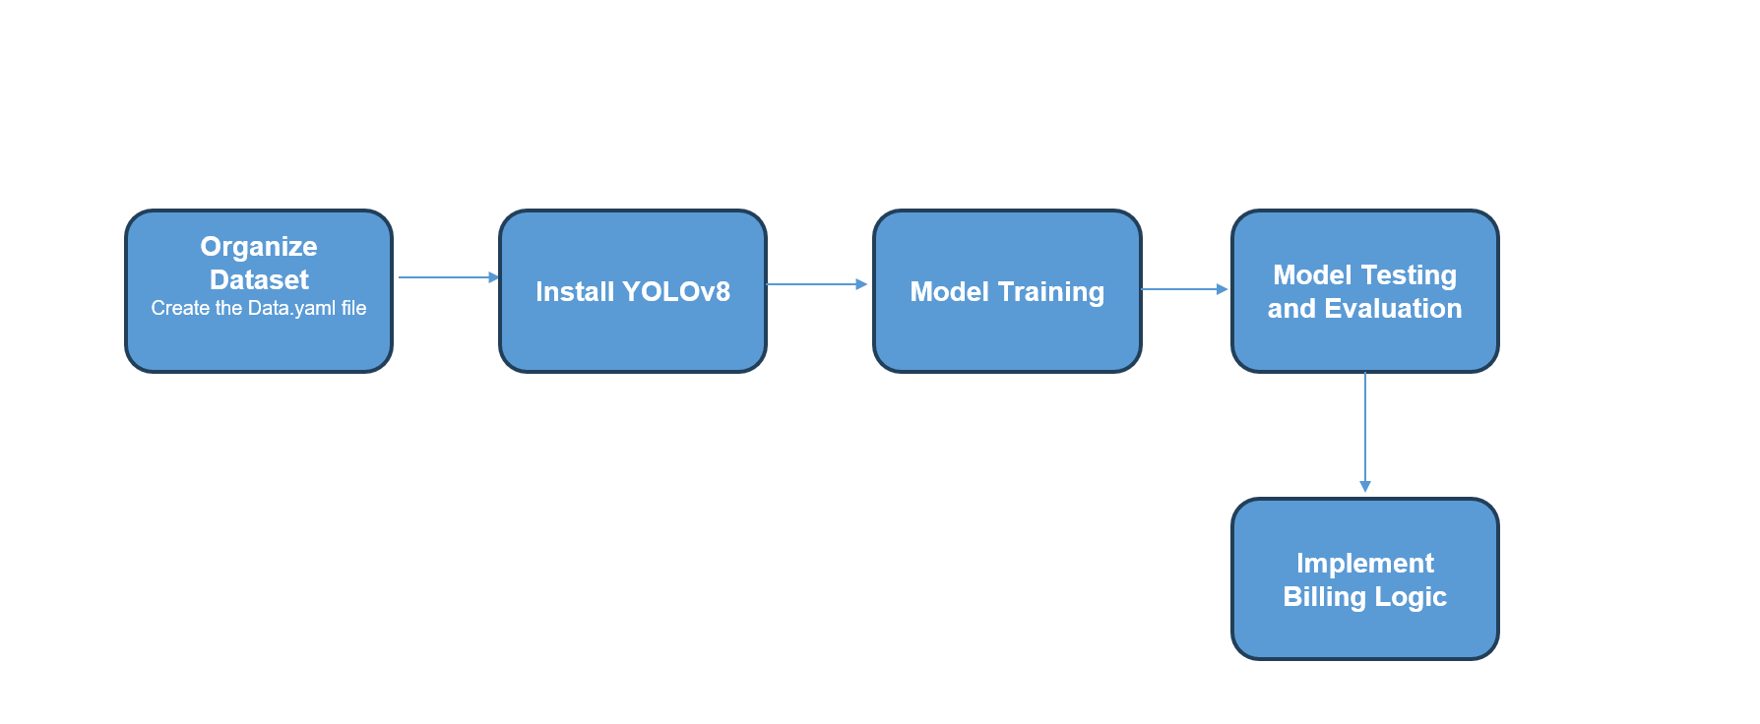
Proposed Methodology [ Max. 3 Slides ]

Slide 9
Dataset
Name of Dataset : Freiburg Groceries Dataset.
Source of Dataset : https://github.com/PhilJd/freiburg_groceries_dataset.
No. of Observations : The dataset contains 5000 images. It covers 25 different grocery categories like chocolate, beans, candy etc.
Column/Feature Details : The dataset consists of labeled images categorized into 25 grocery product types. It includes:
Image File – Path to the image
Class Label – Category of the grocery item (e.g., Chips, Beans, Water, Candy)

Slide 10
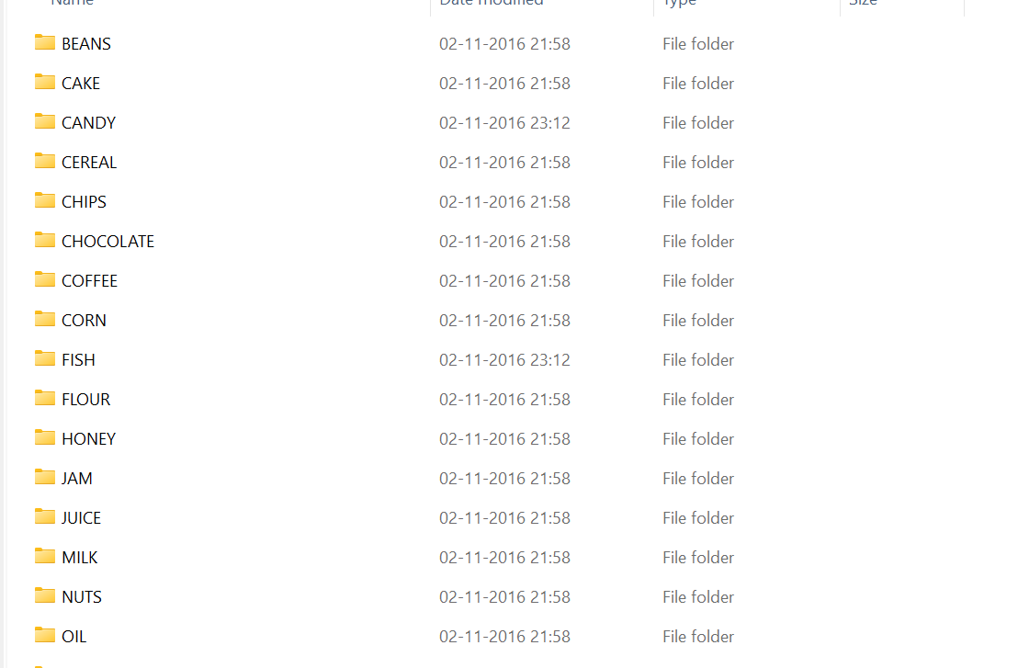
Screenshot of Dataset

Slide 11
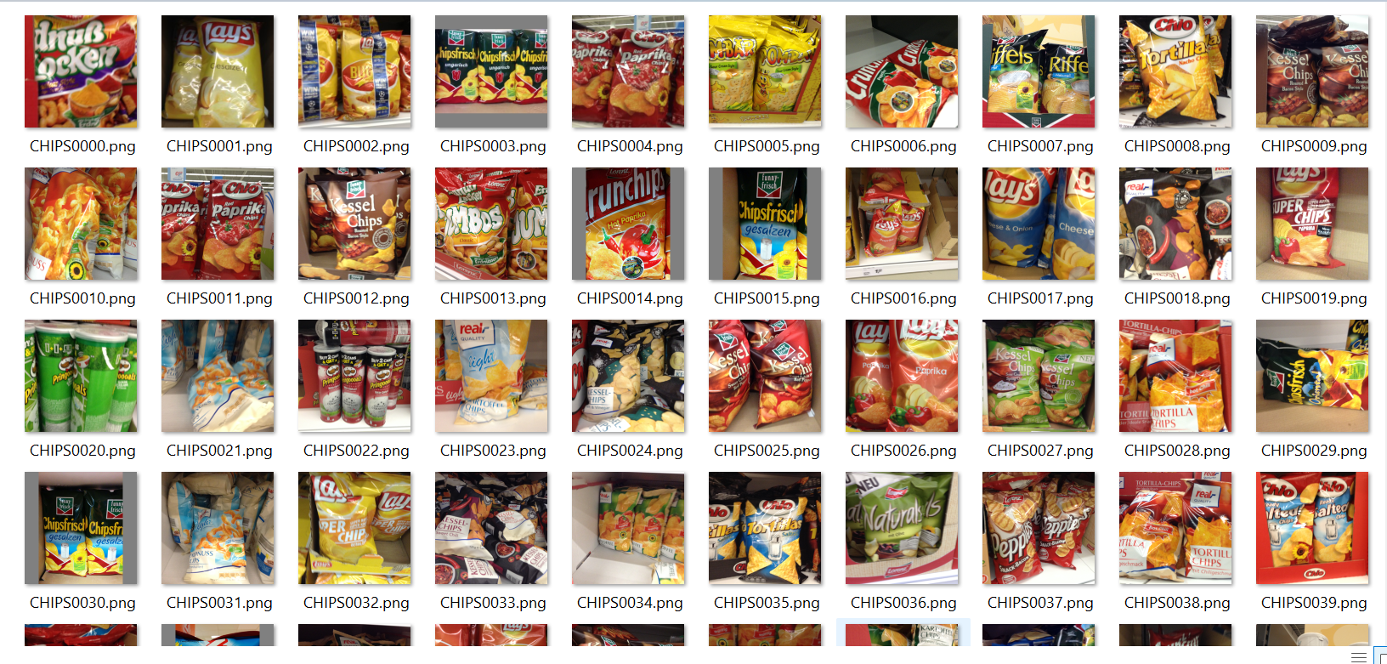
Screenshot of Dataset

Slide 12
Data Pre-Processing
Image Resizing: All images standardized to a fixed size as required by the YOLO model.
YOLO Format: Dataset included annotations with class ID and normalized bounding box coordinates — ready for training.
Train-Test Split: The dataset came with predefined training and validation splits for efficient model evaluation.

Slide 13
Exploratory Data Analysis
1. Class Distribution
We analyzed the frequency of each object class in the dataset using Seaborn bar plots.
The dataset consists of 25 grocery item categories such as milk, cereal, pasta, juice, vinegar, etc.
From the EDA, we observed that:
Milk, juice, and coffee are among the most frequently labeled items.
Items like cake, soda, and honey appear less frequently in comparison.

Slide 14
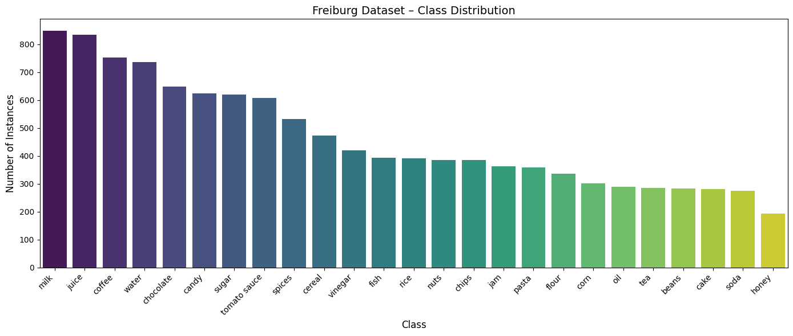
EDA Screenshot

Slide 15
EDA
2. Number of Objects per Image
We analyzed how many objects are present in each image.
Most images have 1 to 3 labeled objects, with a few images containing more.
This suggests that:
Many images represent individual items.
Some images have multiple items, indicating varied complexity in detection.

Slide 16
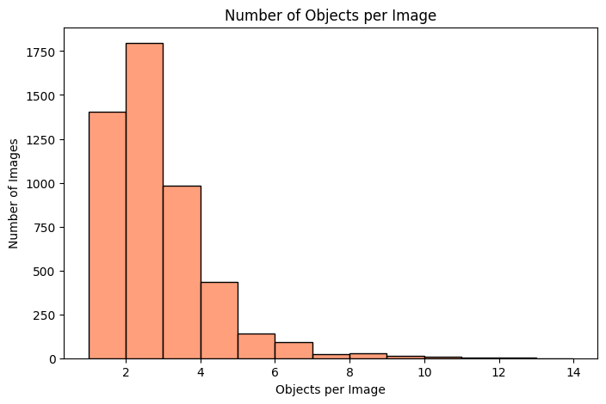
EDA Screenshot

Slide 17
Results and Discussion
After the completion of Data Preprocessing and Exploratory Data Analysis, The next step was training the YOLOv8 Model.
The YOLOv8 model was trained for 50 epochs on the Freiburg Groceries Dataset.
The model demonstrated strong performance in detecting and classifying multiple grocery items in real-time.
It accurately recognized items even in cases of partial occlusion and overlapping.
Visual inspection confirmed correct bounding box placement and label prediction.

Slide 18
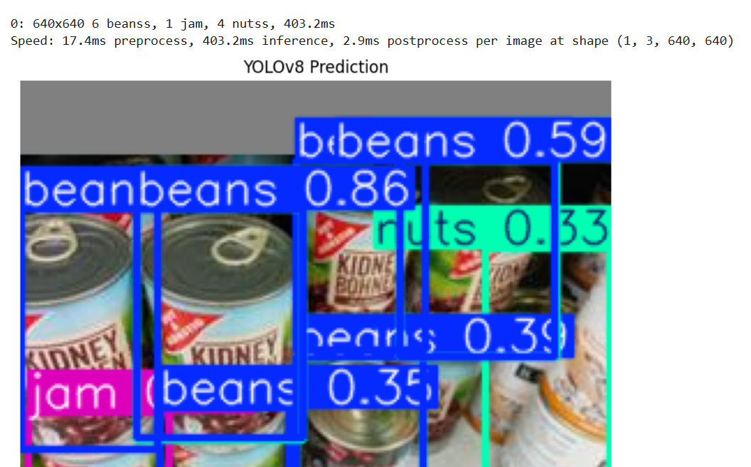
Screenshot of Prediction

Slide 19
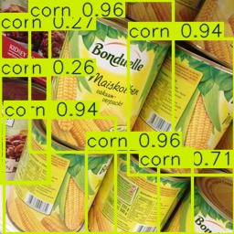
Screenshot of Prediction

Slide 20
Billing Logic
YOLOv8 detects grocery items from the input image with bounding boxes and class labels.
Detected labels are matched to product names in the database.
Quantity is estimated by counting the number of each detected item.
Unit prices are fetched from a predefined price list.
Total price is calculated for each item (quantity × unit price).
A complete bill is generated showing all items, quantities, and prices.

Slide 21
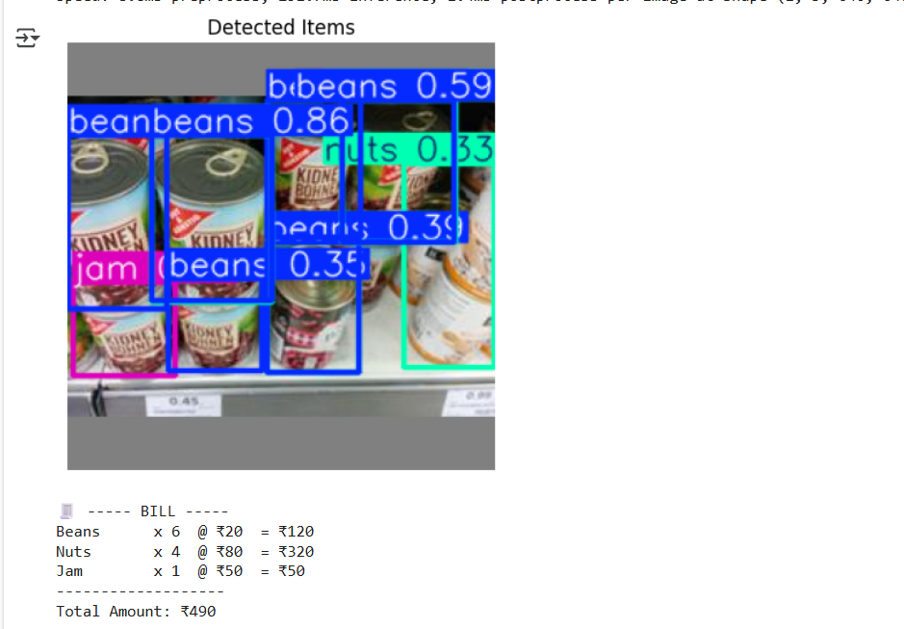
Screenshot of prediction with Billing Logic

Slide 22
User Interface for Automated Billing System
An User Interface was built using Streamlit for simplicity and rapid deployment.
Users can upload grocery item images directly through the interface.
A “Submit” button triggers the YOLOv8 model for object detection.
Detected items are shown in an annotated image with bounding boxes.
A structured table displays item names, quantity, unit price, and total.
The final bill is generated and displayed below the results.

Slide 23
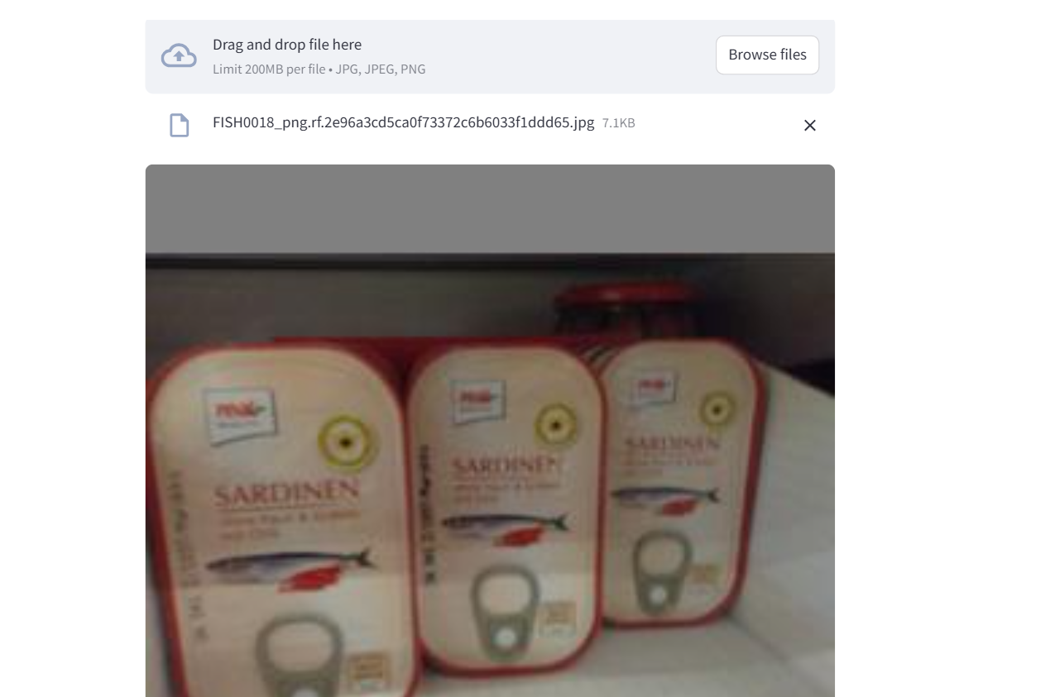
Screenshot of UI(Input Image)

Slide 24
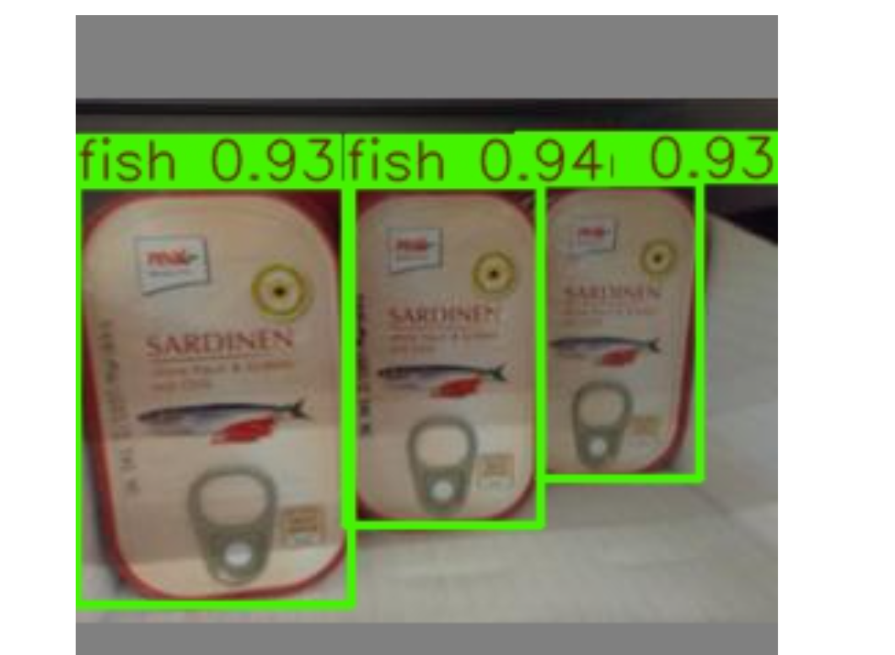
Screenshot of UI(Output Image)

Slide 25
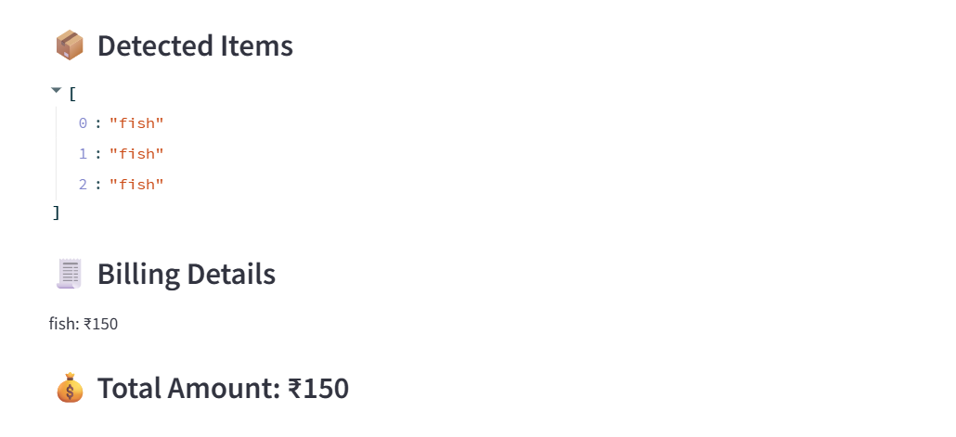
Screenshot of UI(Generated Bill)

Slide 26
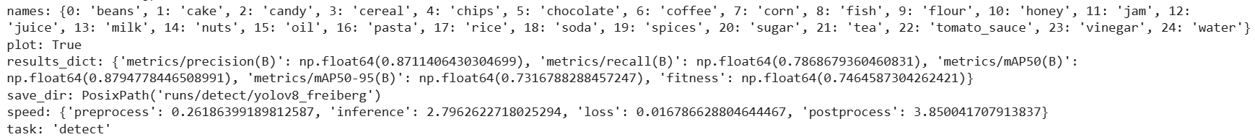
Performance Analysis
Loss value is very minimal which is 0.01. Base paper got accuracy of around 70% whereas our model achieved a loss of .01 which is very minimal and the accuracy is also better.

Slide 27
Conclusion
Used the Freiburg Groceries Dataset consisting of various everyday grocery items for training and evaluation.
Performed data preprocessing and conducted exploratory data analysis (EDA) to understand class balance and image quality.
Trained the YOLOv8 model for 50 epochs, achieving a very low loss of 0.01, indicating strong learning capability.
The model effectively detected and classified multiple grocery items in real-time, even under occlusion and overlap.
Outperformed the base paper, which reported ~70% accuracy — our model delivered superior accuracy and robustness.
Implemented a billing logic to estimate quantities, retrieve prices, and compute the total bill.
Developed an intuitive Streamlit-based UI to allow users to upload images, view detection results, and receive a generated bill instantly.

Slide 28
Future Enhancement
Extend the dataset to include Indian grocery items for region-specific detection and billing.
Integrate a real-time billing logic that dynamically updates totals based on detected items.
Deploy the system on edge devices (e.g., Raspberry Pi, Jetson Nano) for portability and on-site usage.
Add a voice-based assistant or multilingual interface to improve accessibility for diverse users.

Slide 29
References
Base Paper:
Chidella, N., Reddy, N. K., Reddy, N. S. D., Mohan, M., & Sengupta, J. (2022, May). Intelligent Billing system using Object Detection. In 2022 1st International Conference on the Paradigm Shifts in Communication, Embedded Systems, Machine Learning and Signal Processing (PCEMS) (pp. 11-15). IEEE. https://ieeexplore.ieee.org/abstract/document/9807953/
Paper I:
Meenpal, T., Khan, M. S., & Sahu, M. (2024, June). Automatic Food Billing System of Indian Food using YOLOv8 model. In 2024 15th International Conference on Computing Communication and Networking Technologies (ICCCNT) (pp. 1-6). IEEE. https://ieeexplore.ieee.org/abstract/document/10725087/
Paper II:
Jund, P., Abdo, N., Eitel, A., & Burgard, W. (2016). The freiburg groceries dataset. arXiv preprint arXiv:1611.05799. https://arxiv.org/abs/1611.05799
Paper III:
Liyakat, K. K. S., Karale Aishwarya, A., Halli, U. M., Kazi, V., & Kazi, S. Smart Billing Cart Using RFID, YOLO and Deep Learning for Mall Administration. https://www.researchgate.net/profile/Kutubuddin-Kazi/publication/371275693_Smart_Billing_Cart_Using_RFID_YOLO_and_Deep_Learning_for_Mall_Administration/links/654da7adce88b87031d8d458/Smart-Billing-Cart-Using-RFID-YOLO-and-Deep-Learning-for-Mall-Administration.pdf
Paper IV:
Dahal, B., Bhatta, S., Acharya, S., Shrestha, A., & Acharya, P. (2024). Automated Retail Billing: Streamlining Checkout with QR Codes and Object Tracking Using YOLOv8 and DeepSORT. https://www.academia.edu/download/118668175/IJSET_V12_issue5_747.pdf

